Slide 1

Surveillance Technology Public Comment Meeting
Seattle Department of Transportation
Seattle Fire Department

Slide 2
Welcome to Public Engagement Session: SDOT and SFD

Slide 3
City of Seattle’s Definition of Surveillance
Surveillance is defined as technologies that "observe or analyze the movements, behavior, or actions of identifiable individuals in a manner that is reasonably likely to raise concerns about civil liberties, freedom of speech or association, racial equity or social justice."
Certain technologies, such as police body cameras and technologies for everyday office use, are excluded from the law.

Slide 4
Rundown of Events
SDOT will present on technologies currently in use
SFD will present on technologies currently in use
10 minutes Q&A
Break into smaller conversational groups
Each group will feature a facilitator and a notetaker
Provide written comments

Slide 5
How to Comment on Technologies
Comment card
Comment online at seattle.gov/privacy
Mail a comment to Surveillance & Privacy Program: Seattle IT, PO Box 94709, Seattle, WA 98124

Slide 6
Ground Rules
We are here to talk about the technologies currently in use
Be polite and allow others to have time to speak
Keep it civil and respectful

Slide 7
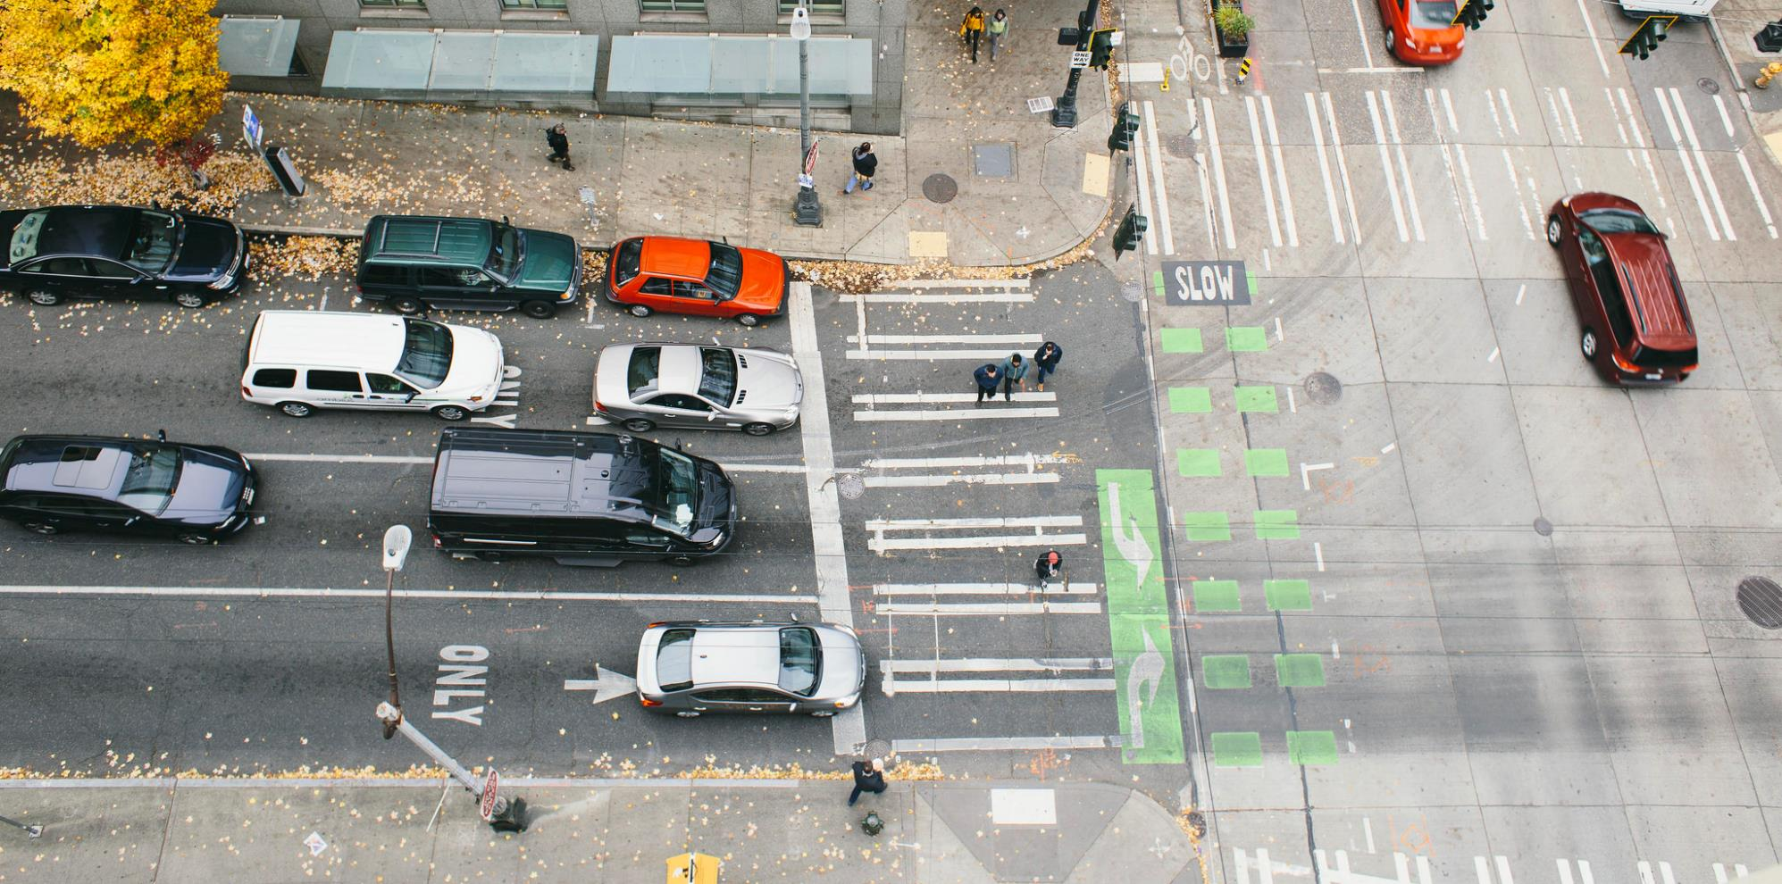
Supporting safety and mobility via real-time technology
Traffic cameras and license plate readers
Surveillance Public Engagement Meetings
Seattle Department of Transportation
10/25/18 and 11/5/18

Slide 8
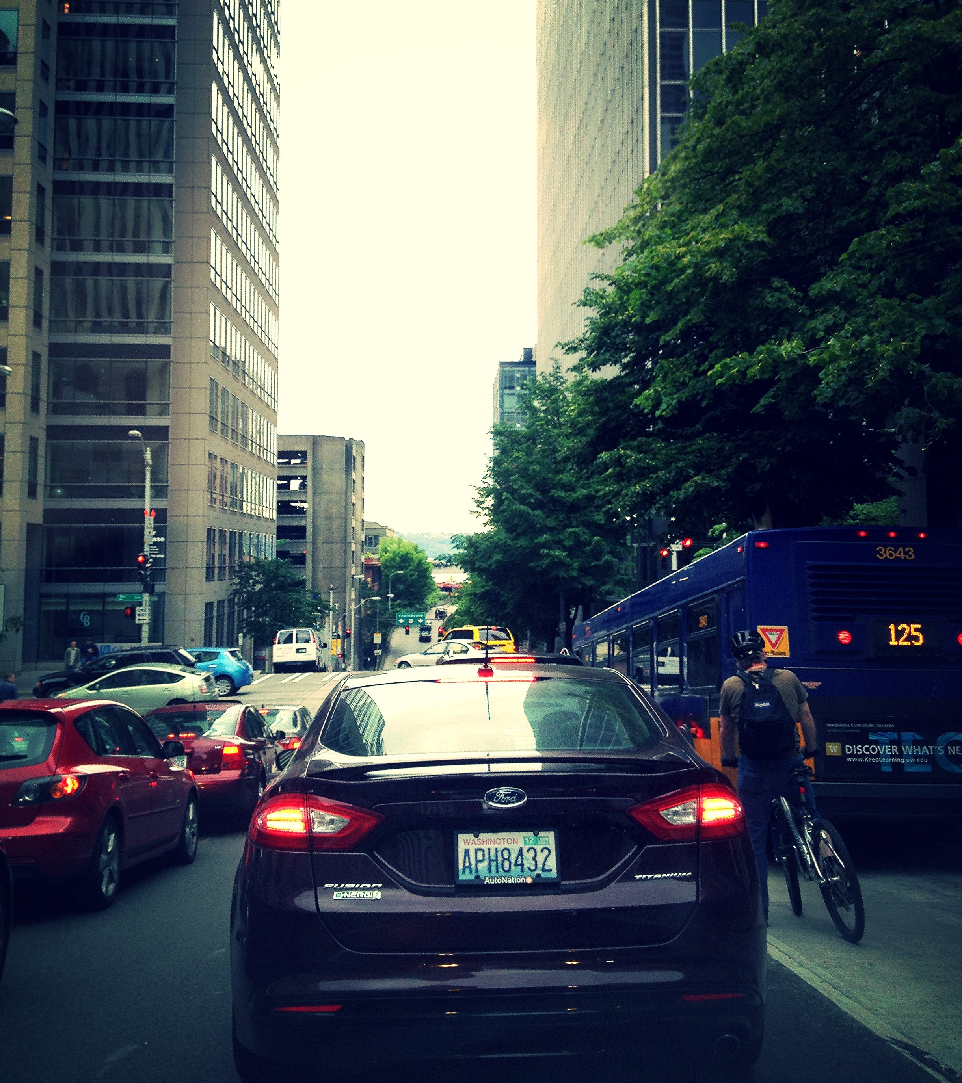
Taking a step back + looking ahead
Seattle is growing, but our streets are not
How we do we make best use of limited space?
What's the role of technology in making our system safer, more efficient, and reliable?
Upcoming constraints
Notes:
Taking a step back: how do we support safety and mobility in the context of growth, construction, and constraint on limited street space
Tie back to long-term ITS strategy and upcoming POMC
This presentation, will cover 2 primary technologies – traffic cameras and license plate readers, that are key to City's ability to keep people and goods moving safely

Slide 9
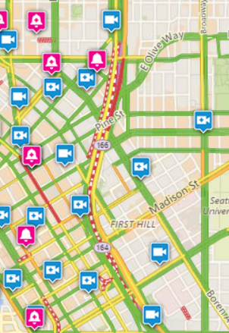

Traffic cameras
Why do we use them?
Decrease travel delays and improve safety
Help detect incidents and respond quickly
Inform and respond to public
Support response during regional emergencies
Notes:
Decreased travel delays; improved public health and safety
Timely response to public questions and observations of traffic conditions and signal operations
Reduces maintenance response time, as staff can observe and understand conditions before traveling to a location

Slide 10
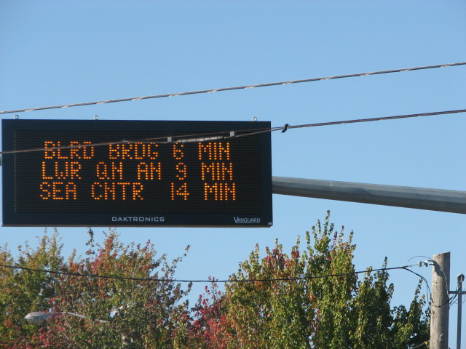
License plate readers (LPRs)
Why do we use them?
Produce travel times
Notify public to make real-time choices
Travel time measures system performance
Dynamic message sign on Holman Rd
Notes:
We use travel times derived from LPRs to:
Post travel times on dynamic message signs
Provide congestion information to public via Travelers map
Assess overall congestion and improve operations to reduce travel time, make travel time more predictable, and compare operations across the City transportation network

Slide 11
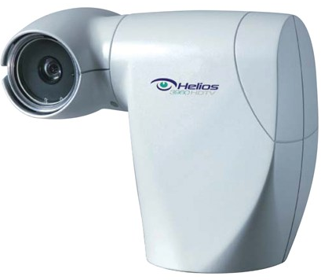
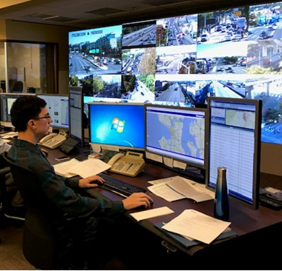
Traffic cameras
What + where are they?
Provide live video to SDOT’s Transportation Operations Center
Remotely controllable, dedicated to observing traffic
Began using in 2000; 225 cameras today
Used by DOTs in every state
Anyone can access live footage and snapshots via SDOT’s Travelers map
Cameras provide our TOC with live video
Notes:
SDOT has a dedicated staff in our Transportation Operations Center who work 24 hours a day, and 7 days a week to help keep traffic moving in Seattle
The teams uses a variety of methods to help understand current conditions on our streets, so we can make a coordinated effort to clear traffic impacting incidents as quickly as possible
and one of their primary tools are traffic cameras
We have 225 cameras installed on major corridors throughout the City, which are remotely controllable from the center so they have an good understanding of what’s happening and impacting traffic
And we’re not alone in using traffic cameras as DOT’s in every state use them in a similar fashion

Slide 12
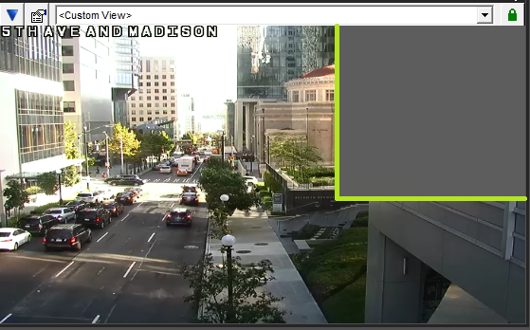
Traffic camera policies
Rules to protect individual privacy
Camera views masked to prevent viewing occupants in nearby buildings
Staff trained not to zoom in on individuals or license plates
Notes:
We also use policies and software to try and ensure individuals can’t be identified using traffic cameras:
The first thing we do is leverage software masking to obscure what a camera can see, and this picture shows how we’ve masked an office building which is adjacent to where a camera is installed
Our team is also trained to never zoom in on a person or license plate, but to simply use the cameras to best understand how traffic is moving

Slide 13
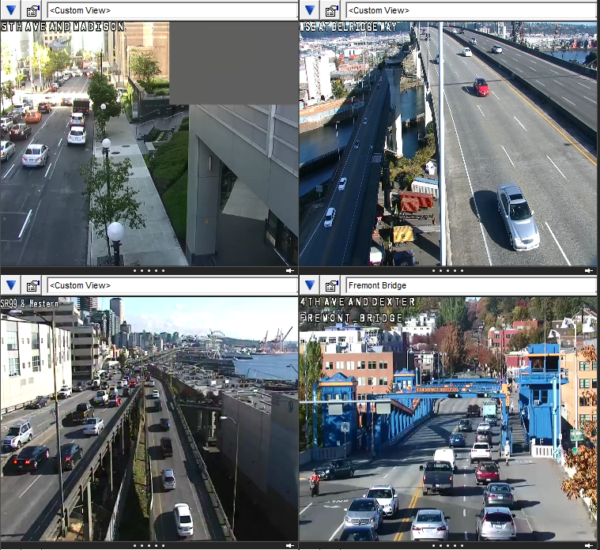
What happens with the camera data?
Video recorded occasionally for SDOT traffic studies (not for enforcement)
Recordings permanently deleted within 10 days
Never shared with other departments or agencies
Notes:
We do sometimes record the cameras but they’re strictly for the Transportation Operations Division
An example of when we might record a camera is when reviewing new traffic signal timing to make sure that’s it’s ideal or if there are still some modifications to be made
All recordings are kept on a server only accessible by SDOT personnel, and they’re always deleted after 10 days max, and the video is never shared with any other agency or used for enforcement
All cameras are also available to view live on our Traveler Information Map, so I encourage everyone to take a look at seattle.gov/travelers which provides current information for trip takers such as congestions information, rail road closures, and bridge openings. You can also view any of the cameras whenever you want, and we try to be completely transparent, as we’re not using these cameras for any reason except to help keep Seattle’s traffic moving as efficiently as possible

Slide 14
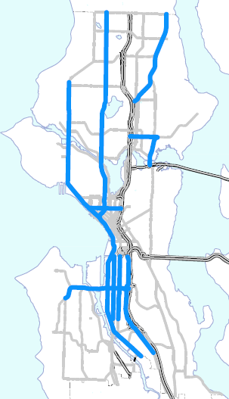
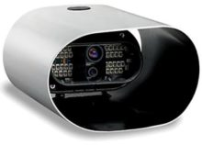
License plate readers (LPRs)
What + where are they?
Began using in 2011; deployed on 15 primary corridors
Combination of camera and computer processor
Use software to turn photos of license plates into digital records
Notes:
The other solution that we’re going to discuss this evening are the License Plate Reader cameras that we use to get travel time information along our major corridors
This is more of a legacy solution and we’re no longer installing them for that purpose, but they still are in production on 15 of our primary corridors including SR-99, 15th Ave NW and Elliott, SODO, and the West Seattle Bridge

Slide 15
License plate readers (LPRs)
Capture images
Compare time stamps
Estimate travel times
How do they work?
Captures 5-10% of license plates as they move into view
Images --> WSDOT, software records plate number, adds time stamp
WSDOT software scans for plate matches at successive LPR stations
Compare time stamps of matches → estimate travel time (WSDOT sends us these estimates)
Notes:
So how do they work?
The cameras capture a license plate when it comes into view and creates a digital stamp
We then send that information to the Washington State Department of Transportation who also use license plate readers to create travel times, and they do the processing on our behalf
When the same plate is detected at a second location we have a travel time from point A to point B, and once we have a collection of those 5 of those trips in a 5 minute period, those trip are averaged and a travel time is produced
Approximately 5-10% of vehicles are matched in any 5 minute period
The raw data is never available to SDOT, and WSDOT immediately deletes that information after making a match
SDOT only receives aggregated travel times back from WSDOT, and these devices are never used for any type of legal enforcement by SPD or Washington State Patrol

Slide 16
What happens with the LPR data?
License plate numbers immediately deleted once travel time is calculated
SDOT never receives individual license plate numbers
Never used for enforcement

Slide 17

Questions?
Mark.Bandy@seattle.gov | (206) 684-5097
Jason.Cambridge@seattle.gov | (206) 684-5121
www.seattle.gov/transportation/projects-and-programs/programs/technology-program
www.seattle.gov/transportation
Notes:
Thanks, and I think we have a few minutes for any questions about Traffic Cameras or License Plate Readers

Slide 18
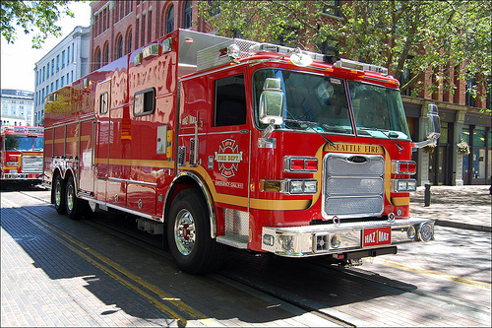
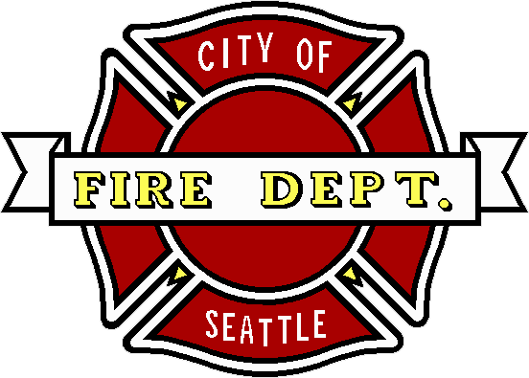
Seattle Fire Department
Digital + Hazmat Cameras

Slide 19
Summary of Seattle Fire Department
Mission
The mission of the Seattle Fire Department is to save lives and protect property through emergency medical service, fire and rescue response and fire prevention. We respond immediately when any member of our community needs help with professional, effective and compassionate service.
Vision
The Seattle Fire Department: a national leader in responding to and preventing emergencies with a commitment to excellence and teamwork.
Values
Compassion, Courage, Diversity, Integrity, Teamwork

Slide 20
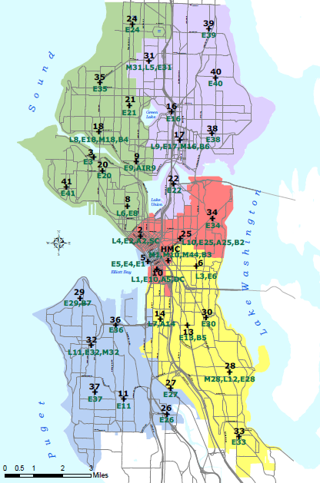
Facts about your Seattle Fire Department
Stations & Apparatus
33 Fire Stations
Medic One at Harborview Medical Center
33 Engines, 11 Ladder Trucks, 5 Aid Units (BLS), 7 Medic Units (ALS), Additional specialized apparatus
Number of Responses
Over 100,000 Annual Incident Responses
Roughly 20,000 ALS responses each year
50-100 Hazmat responses each year

Slide 21
An old Saying
The idiom “A picture is worth a thousand words” also applies in emergency settings.
Cameras are an invaluable tool for first responders, and their use in communication helps us in our mission to prevent the loss of life and property.

Slide 22
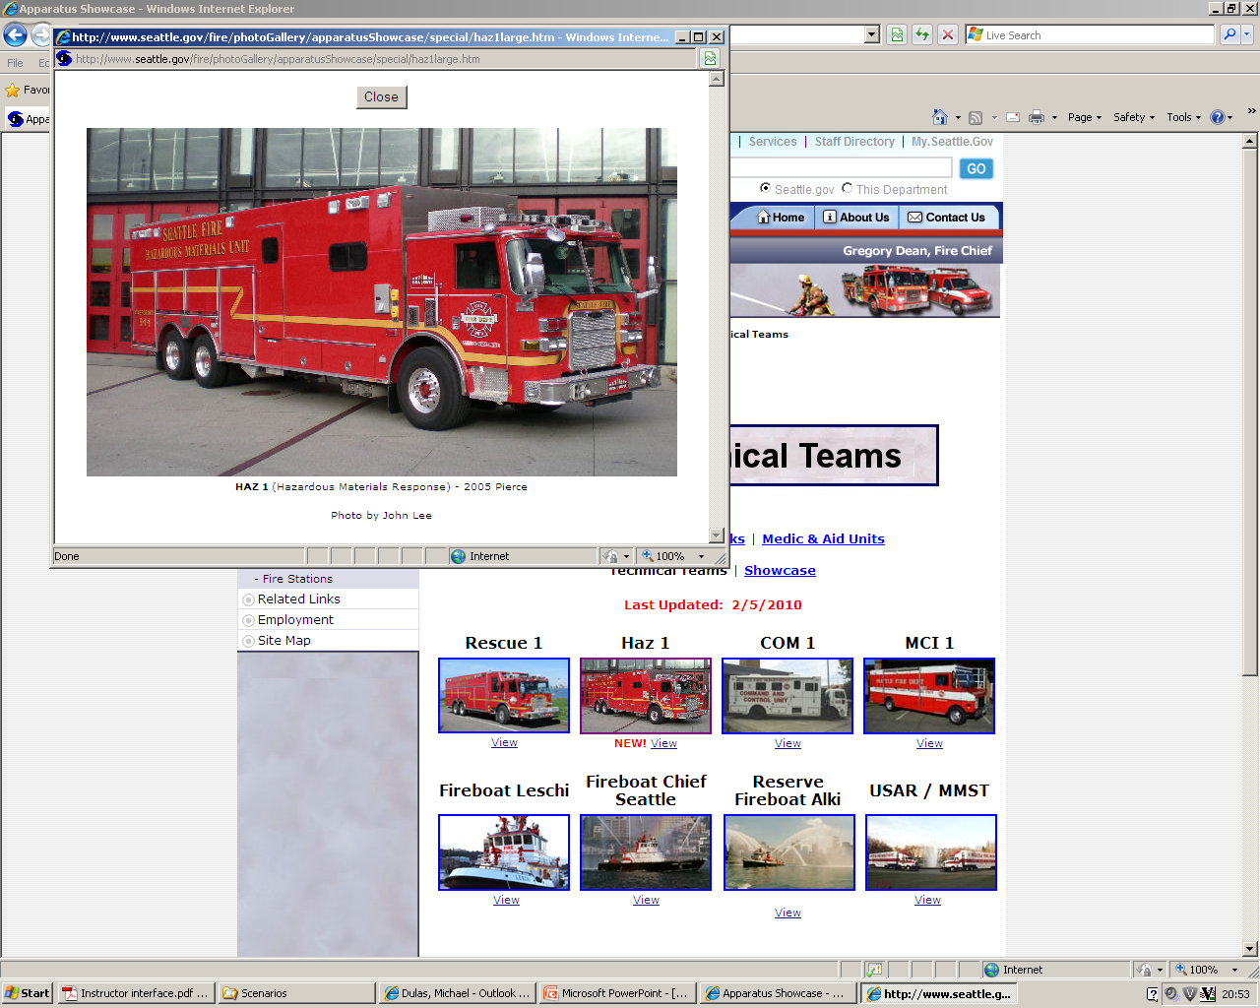
Hazardous Materials (HAZMAT) Camera
The Seattle Fire Department’s Hazardous Materials (HazMat) specialty team, known as Unit 77, utilizes a camera system to explore incident scenes for potentially hazardous materials, spills, or contamination.
First responders use Apple’s Facetime, a video conferencing application, in conjunction with Apple TV to livestream video via an iPad and MiFi connection to a television monitor located on the HazMat Unit. The Facetime application also allows for screenshots to be taken for later review or dissemination to law enforcement as necessary.

Slide 23
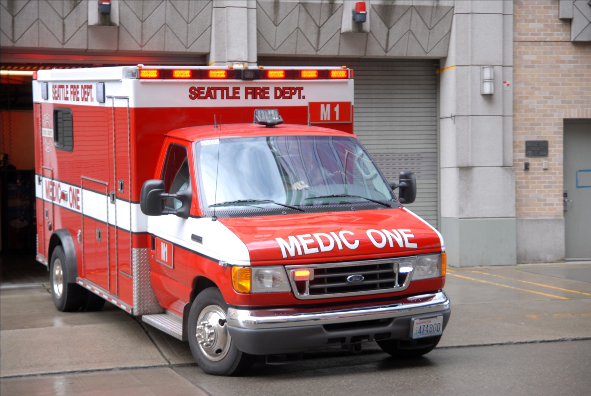
Digital Cameras
Certain Seattle Fire Department apparatus maintain a digital camera for use during emergency operations. These cameras may be utilized by Department personnel in several ways:
Providing emergency medical doctors with
pictures of trauma patient injuries.
Pictures of fire scenes for Fire
Investigation Unit (FIU) investigations.
Safety investigations following
collisions involving Department apparatus.

Slide 24
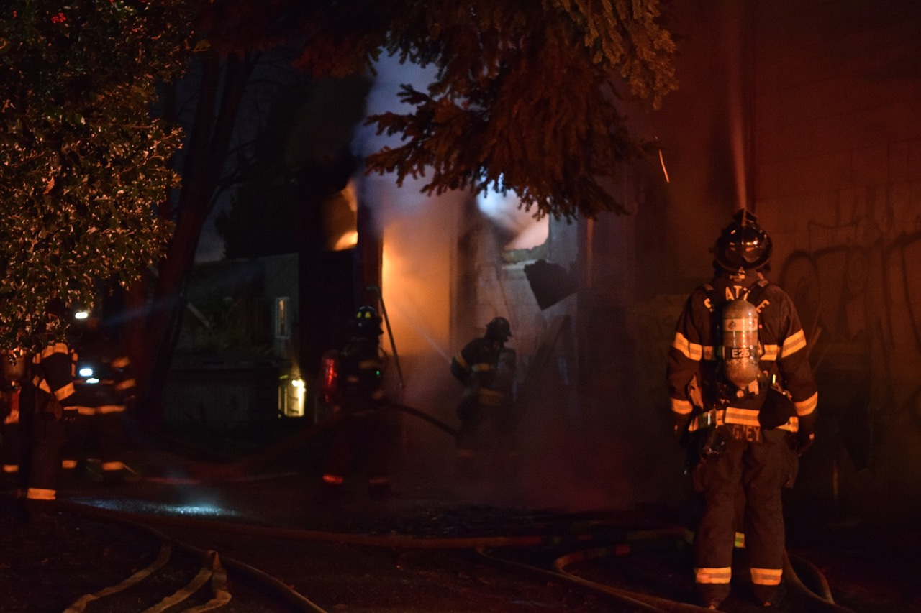
Questions?

Slide 25
Small Group Discussion
10 minute discussion: Traffic Cameras

Slide 26
Small Group Discussion
10 minute discussion: License Plate Readers (LPR)

Slide 27
Small Group Discussion
10 minute discussion: Emergency Scene Cameras

Slide 28
Small Group Discussion
10 minute discussion: HazMat Cameras

Slide 29
What’s Next?
Upcoming public meetings through 11/5
Comments collected will be included in the SIR submitted to the Surveillance Advisory Working Group, and then City Council for full Council vote.

Slide 30
Ways to Comment
Seattle.gov/privacy
Fill out a comment card
Mail a comment to Surveillance & Privacy Program: Seattle IT, PO Box 94709, Seattle, WA 98124

Slide 31
Thank you for joining us!

